Slide 1
TamilNadu college of Engineering
PHASE-4 SUBMISSION
AI DRIVEN EXPLORATION AND PREDICTION OF COMPANY REGISTRATION TRENDS WITH REGISTER OF COMPANIES (ROC)
1. MUTHUSELVAM.P
2. RAHUL SARATH.A
3. SURIYA MOORTHI.S
4. MURUGESH.M
5.RUGESHWARAN.C
TEAM MEMBER
Phase 4: Development part 1
AI PREDICTION ROC

Slide 2
INTRODUCTION
The Registrar of Companies (RoC) plays a pivotal role in the regulatory framework of a nation, overseeing the incorporation and registration of companies, ensuring transparency, and maintaining records of corporate entities. As the business landscape continually evolves, understanding and predicting company registration trends are of paramount importance for policymakers, business analysts, and entrepreneurs alike. With the advent of Artificial Intelligence (AI) and machine learning, we have gained the capability to leverage vast datasets and sophisticated algorithms to gain valuable insights into these trends.

Slide 3
Uncover Patterns and Trends: AI-driven analysis allows for the identification of historical patterns and trends in company registrations. By examining data over time, we can gain insights into seasonality, shifts in business types, and geographic concentrations.
Data-Driven Decision Making: Decision-makers in both the public and private sectors can use these insights to make informed, data-driven decisions. Government agencies can allocate resources effectively, businesses can tailor their strategies to market conditions, and investors can make more informed choices.
Risk Mitigation: Predictive models can help identify potential areas of concern or risk, allowing for proactive regulatory action. This is particularly crucial in spotting anomalies or fraudulent activities.
Economic Forecasting: The trends in company registrations are often indicative of broader economic trends. Accurate predictions can provide early indicators of economic health or potential downturns.
Efficiency and Resource Optimization: By understanding registration trends, governments can streamline registration processes, reduce bottlenecks, and optimize the allocation of resources, ultimately reducing administrative burdens on businesses.

Slide 4
ALGORITHM
Exploration and Prediction of Company Registration Trends with RoC Data
Data Collection:
Obtain historical company registration data from the Registrar of Companies (RoC). This data might include company registration dates, types of companies, geographical locations, and other relevant information.
Ensure the data is in a structured format for analysis.

Slide 5
Data Preprocessing:
Clean the data by handling missing values, removing duplicates, and addressing any inconsistencies.
Convert the data into a suitable format (e.g., Pandas DataFrame) for analysis.
Data Exploration:
Utilize descriptive statistics and data visualization techniques to understand the dataset.
Create various visualizations (e.g., time series plots, bar charts, heatmaps) to gain insights into company registration trends over time.
Feature Engineering:
Extract or create relevant features from the data that can be used for prediction. Examples include:
Extracting registration dates to obtain month and year.
Encoding categorical variables (e.g., company types) into numerical format.
Aggregating data to different time intervals (e.g., monthly or yearly).

Slide 6
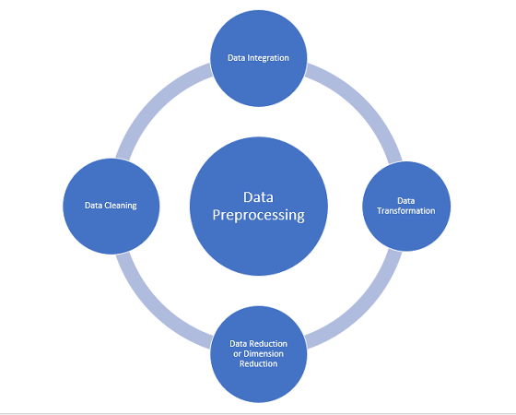

Slide 7
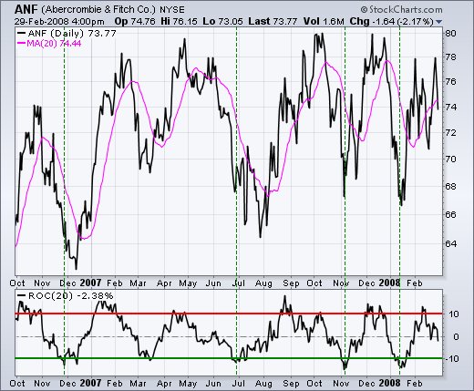

Slide 8
PROGRAM
import pandas as pd
from sklearn.model_selection import train_test_split
from sklearn.linear_model import LinearRegression
from sklearn.metrics import mean_squared_error
import matplotlib.pyplot as plt
# Load your data into a DataFrame
data = pd.read_csv("company_registration_data.csv")
# Perform data preprocessing and feature engineering as needed
# Split the data into training and testing sets
X = data[["feature1", "feature2", ...]] # Use relevant features
y = data["registration_trend"]
X_train, X_test, y_train, y_test = train_test_split(X, y, test_size=0.2, random_state=42)
# Create and train a Linear Regression model
model = LinearRegression()
model.fit(X_train, y_train)

Slide 9
# Make predictions
y_pred = model.predict(X_test)
# Evaluate the model
mse = mean_squared_error(y_test, y_pred)
print(f"Mean Squared Error: {mse}")
# Visualize the data and predictions
plt.scatter(X_test, y_test, color='b', label='Actual')
plt.plot(X_test, y_pred, color='r', label='Predicted')
plt.legend()
plt.show()

Slide 10
CONCLUSION
In the pursuit of understanding and predicting company registration trends with the Registrar of Companies (RoC), the application of Artificial Intelligence (AI) and machine learning has proven to be an invaluable asset. This AI-driven exploration has provided us with insights, tools, and methodologies that have the potential to shape the future of business regulation, policy-making, and strategic decision-making in both the public and private sectors.
The exploration began with the collection and preprocessing of historical RoC data, and we witnessed the power of data as it revealed trends, patterns, and anomalies in the world of company registrations. Through data exploration, we gained the ability to visualize how various factors such as time, location, and business types influence registration trends. These insights lay the foundation for informed decisions.
Feature engineering allowed us to transform raw data into meaningful input for our machine learning models. Categorical variables were encoded, temporal features were extracted, and the data was organized for predictive modeling.

